Slide 1
















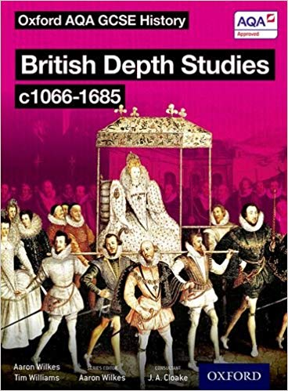






The path through GCSE History at Earl Mortimer College
Year 9
GCSE Unit 1
Health and Medicine
Medicine Stands Still
The Beginnings of Change
A Revolution in Medicine
Modern Medicine
Year 10
GCSE Unit 2
Conflict and WW1
Causes of WW1
Germany and the Depression
Germany and the growth of democracy
GCSE Unit 3
Germany
Ending WW1
Germany under the Nazi’s
WW1: Stalemate
Year11
Elizabeth’s Court and Parliament
Life in Elizabethan Times
Troubles at home and abroad
The Historic Environment
GCSE Revision & Exams
GCSE Unit 4
Elizabeth

Slide 2


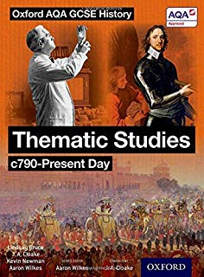






Seneca https://www.senecalearning.com/ a fantastic free resource for students to practice and retrieve their knowledge
BBC Bitesize https://www.bbc.co.uk/bitesize/subjects/zk26n39 has lots of really useful subject and exam board revision
Show My Homework https://www.showmyhomework.co.uk/login
will be used for all homework tasks.
YouTube has a wealth of resources, such as this playlist for Secondary History from BBC Teach https://www.youtube.com/playlist?list=PLcvEcrsF_9zI2dNGU9uUOWo9tenQi93UG
Retaining, recalling and retrieving knowledge learnt.
Encourage your son or daughter to start early, start now on their homework and revision.
Help them be organised. Create a workable homework timetable with them.
Let them talk. Talking with you about a topic or subject helps them visualise their knowledge.
Water and healthy food are vital for the brain to function properly. Make sure they are eating and drinking with you while they talk about their subject.
Exercise & fresh air. Go for a jog with them while they talk about their subject.

